Slide 1





!Kirks House of Cards!
Darius, Shaina, Luke, and Thomas

Slide 2
Why did we choose a Casino Game?
We started with many ideas:
Conway’s Game of Life
Wolfram rules, RGB automata
Digital Audio Workspace
Like FL studio
2D Physics Simulator
Chess
2D Platformer

Slide 3
Why did we choose a Casino Game?
Uses many programming skills, seemed fun
randomness, GUI design (JavaFX), and logic
Three main sections: games, the bank, and main menu
split work and maintain communication
Each person could also work on each game
The project allowed us to practice design, programming and teamwork while also challenging us to stay creative and deliver a strong user experience.

Slide 4
Why did we choose a Casino Game?
We selected a casino game because it enables us to use many programming skills while being fun and engaging. It includes elements such as randomness, GUI design, and logic. The casino game structure consists of three main sections which include games, the bank and main menu so we can split the work and maintain communication. The project allowed us to practice design, programming and teamwork while also challenging us to stay creative and deliver a strong user experience.

Slide 5
Process
We first decided to use JavaFX as our library because it contained all the visuals, buttons, scene switches that was needed.
Our group then picked each casino game based on what we knew was achievable within the couple weeks we had
We first created the games in the console before using JavaFX
We each started by working on a specific part of the project, such as a different game or feature, and then brought everything together near the end to create the full casino experience.

Slide 6
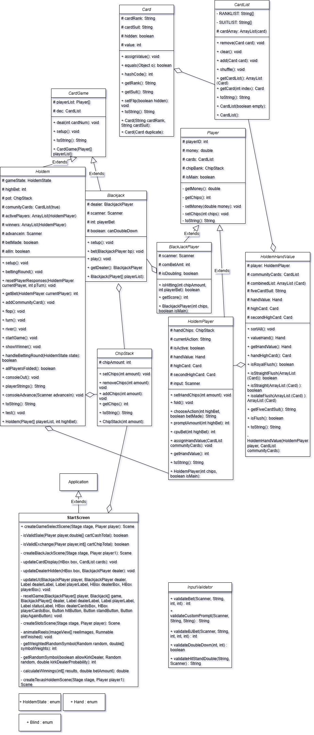
UML Diagram

Slide 7
Design for Start Screen (methods)
start(Stage stage)- establishes the main screen by creating Start, Achievements, Save, and Close buttons which define their actions.
createGameSelectScene(Stage stage)- when the start button is clicked, it creates the next scene
The main menu of the game presents four main buttons which include Start, Achievements, Save and Close. The buttons have custom hover, pressed, and normal images to achieve a good UI. The Start button takes the player to the game selection screen while the Close button closes the game. The game selection screen (after pressing Start) allows players to access features such as the Bank which enables cash to chip exchanges through interactive arrow and buttons. This displays current cash and chip balances. The Achievements section displays prizes including a ring, car, house and island which players can earn. The entire interface uses custom backgrounds ,fonts and images to build an enjoyable casino-like atmosphere

Slide 8
Design for Black Jack (Methods)
BlackJack Class
Setup()- The game starts with two cards given to each player and the dealer. The dealer maintains a distinct hand with one concealed card.
Play()-The main game loop: controls betting, player decisions (hit/stand/double), dealer logic, and determines winners/losers based on scores.
Bet(BlackJackPlayer bp)- controls the betting amounts for each player whether they are users or computers by deducting those amounts from their chip bank.
BlackJackPlayer Class
IsHitting ( int chipAmount, int Player bet)- determines player actions through hit, stand or double down options. The computer player makes decisions automatically based on score.
Getscore()- function determines the total hand value of the player while properly managing dynamic handling (such as Aces being worth either 11 or 1.)

Slide 9
Design for Texas Hold’em[Methods]
Holdem Class
StartGame()- The entire Hold'em round flow is controlled by this (setup → flop → turn → river → showdown).
BettingRound()- The system controls one betting round for all active participants.Each player selects from four possible actions which include calling, betting, raising or folding.The system addresses situations when a player goes all-in while it manages the pot and player chip stack amounts.
Setup()- preparation of the game.Each player receives an ID through the assignment process.The game establishes small and big blind positions.Each player receives two hole cards as part of the deal.
HandelingBettingRound (Holdem State state)- A helper to manage betting and check for game-ending conditions (all others fold).
ShowWinner()- distrubutes pot and calls winner
HoldemPlayer
ChooseAction ( int Highbet, boolean BetMade)-This function retrieves the player’s decision (check, bet, raise, fold) during betting.
AssignHandValue( CardList communityCards)- determines the power of the player's hand and saves this information.
setHandChips(int amount)- During betting the player transfers their chips from their bank to the pot.
Fold()- if the player decides to fold/stop playing
HoldemHandValue
valueHand()- The system determines the highest possible hand that the player holds (straight, flush, etc.).
getHandValue()- The game determines which hand type the player will receive (Full House, Straight, Flush, etc.).
isStraightFlush(ArrayList<Card> cards)- is it a straight flush?
handHighCard()- chooses the highest card
isStraight(ArrayList<Card> cards)- Detects if a hand has a 5-card consecutive sequence.
IsRoyalFlush()- royal flush

Slide 10
Design for Slots [Methods]
start(Stage primaryStage)- The application sets up the UI while it initializes media, fonts ,layout containers and event handlers.
spin() - activates when user clicks on the spin button. The spin() method has the following responsibilities: to check the bet amount, to reduce the balance, to play the spin sound, to start the animation by animateReels(), to determine the type of spin (match, different, or random) and to calculate and update the winnings by calculateWinnings().
animateReels(Runnable onFinished)- animates the spinning of the slot machine reels by cycling through random symbols over a set period of time, and calls the onFinished callback once the animation is complete.
calculateWinnings(int[] results, double betAmount)- evaluates the final symbols after the spin to determine if the player has achieved any winning combinations, applies the corresponding multipliers based on the results, and returns the total amount won.
getWeightedRandomSymbol()- chooses a random symbol according to probability weights which results in kirkDealer appearing less often than the common fruit symbols.This is so the user very rarely will get 3 kirkDealers

Slide 11
What we have learned...
Throughout designing this Casino game, our group developed many skills that enhanced our JavaFX abilities to design a GUI. Even though our code is very detailed/comprehensive, the final demo shows an easy-to-use Casino game. This process gave us more exposure to the world of creating video game.
We learned how to:
Use Git and GitHub
Use JavaFX
Coordinate class design
Improve compatibility across devices and IDEs
Relative filepaths, VM arguments

